Slide 1
Event Supervisors and Assistants Training Session

Slide 2
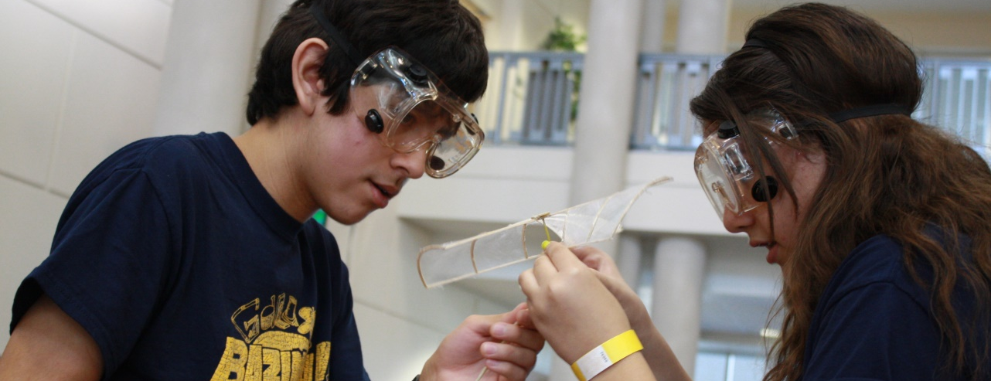
The Science Olympiad was created in 1983 by Dr. Gerard J. Putz and Jack Cairns to increase interest in science and as an alternative to traditional science fairs and single-discipline tournaments. After successful trial Olympiads were held in their respective states of Michigan and Delaware, the Science Olympiad began to grow. Now, the Olympiad has members in almost all of the 50 states, totaling more than 15,000 actively participating K-12 schools.
History of Event

Slide 3
The Science Olympiad is devoted to improving the quality of science education, increasing student interest in science and providing recognition for outstanding achievement in science education by both students and teachers. We hope to achieve these goals through participation in Science Olympiad tournaments, classroom activities, and summer training institutes for teachers. We also hope that our efforts can bring academic competition to the same level of recognition and praise normally reserved for athletic competitions.
Olympiad Goals

Slide 4
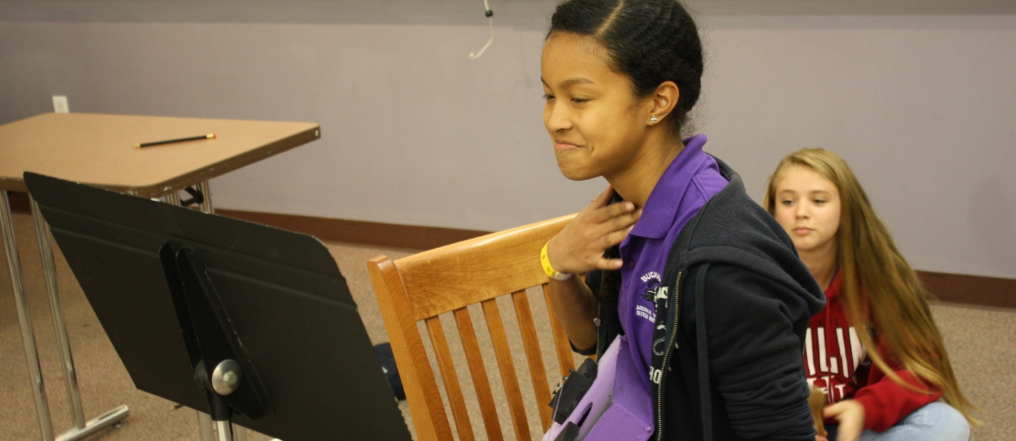
Background and Requirements:
Teams of 12 students, lead by one coach.
Each school can have more than one team.
13 different events
Registration fee of $165 (early) $195 (late)
Competition is May 9, 2015 9:00 am – 3:00 pm
Olympiad Criteria

Slide 5
Division A Events
A is for Anatomy
Bridge Building
Egg Drop
Energy Lab
Estimania
Mystery Packaging
Mystery Powders
Pentathlon
Rock Hound
Solid, Liquids, Gas
Starry, Starry Night
Water Rockets
Who Wants To Be A Biologist
The Events

Slide 6
Rules and Criteria
RULES ARE ALWAYS PRECEDENT
Read over the rules and make sure you understand them.
The rules are complex.
Make sure you understand how the scoring criteria works.
Check for clarifications at eso.floridascienceolympiad.org and click on Events
The students will know them very well!
Rules

Slide 7
Rules:
Bolded items are changes from last year.
Check for items allowed
Check for what YOU need to provided to run event
Check how event is to be scored
Rules

Slide 8
Copies
Send Mike all copies of tests and worksheets and answer sheets by May 1, 2015.

Slide 9
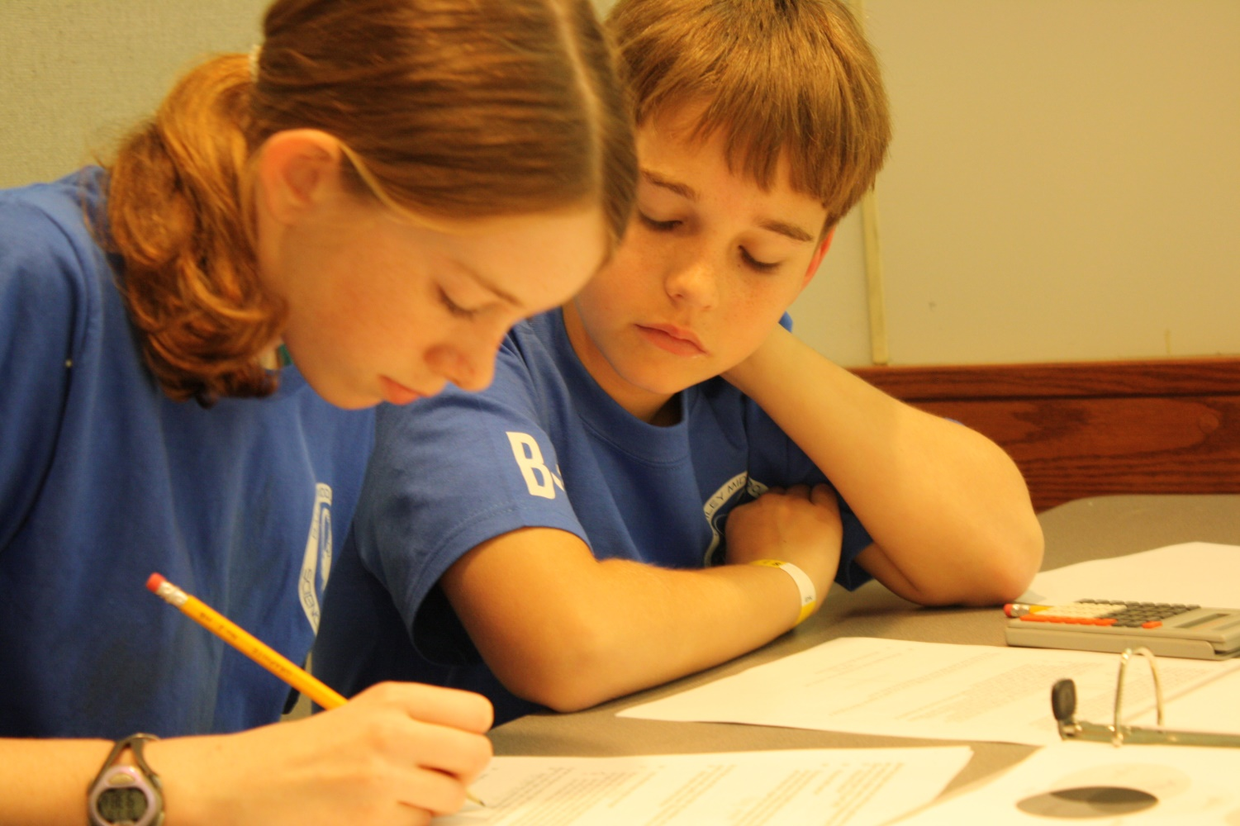
Lab and Research Events

Slide 10
Designing Lab/Research Events
Make sure you write items, questions or activities that are aligned to the rules.
Make several levels of items. Create 1/3 of each at an easy, medium, and difficult level.
Make sure no one can get a 100%. If several teams get 100%, it is difficult to determine 1st place.
Have a system for breaking all ties.
Lab/Research Events

Slide 11
Designing Lab/Research Events
Know how ties will be broken. This could be as simple as posting the questions that will be tie breakers. (For example, Question 1, 3, 5 in that order will break ties.)
Lab/Research Events

Slide 12
Essays
Write an answer key to the essay that you consider an ideal score.
Identify factors that make it ideal.
Determine the number of points for ideal.
Determine what constitutes awarding fewer points.
Lab/Research Events

Slide 13
Calculations
When scoring for calculations, determine a range that will receive highest number of points.
Example: Measuring mass and acceleration to find force, student collects the following data and finds the force to equal 56.7 N:
m = 10.5 kg
a = 5.4 m/s²
A scoring rubric might give: 5 points for 58 and 55
3 points for 61 and 52
0 points if beyond 61 and 52
Lab/Research Events

Slide 14
Designing Lab Events
Be clear and concise about what you want students to do.
Stay away from tricky questions.
Try to do as much hands on as possible.
Ensure that there is a space for NAMES and TEAM NUMBERS
Lab/Research Events

Slide 15
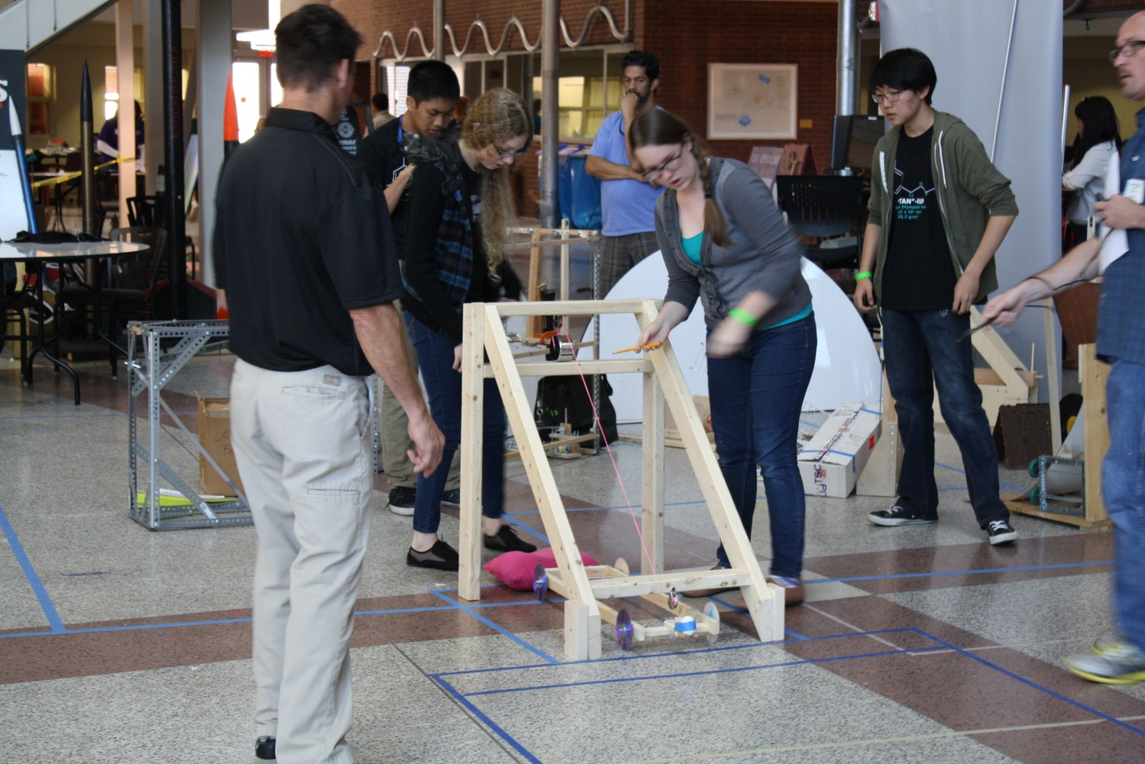
Engineering Events

Slide 16
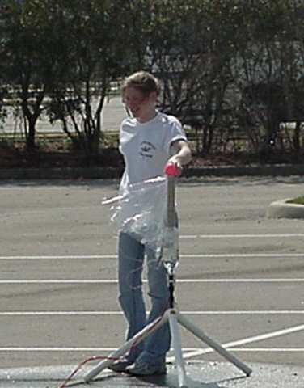
Impounding/Construction
Construction Events:
Bridge Building
Mystery Packaging
Impound Event:
Water Rockets
Engineering Events

Slide 18
Construction Events
If you are Event Supervision at event that requires a device to be constructed, be ready for teams at 9:00
Setup BEFORE 8:00 am
Make sure area is guarded for devices
Make sure teams have team number on devices
Teams must all report during construction period.
Engineering Events

Slide 19
Impounding Engineering Event
If you are Event Supervision at event that requires a device to be impounded, students will have until 10:00 am to turn in.
No modifications are allowed to device after this time. But can suggest that something needs fixed.
Give students a receipt.
Engineering Events

Slide 20
Impounding
Do not release times, distances, and other pertinent information prior to the impounding.
Make sure students have their Team ID numbers and names on the devices.
Engineering Events

Slide 21
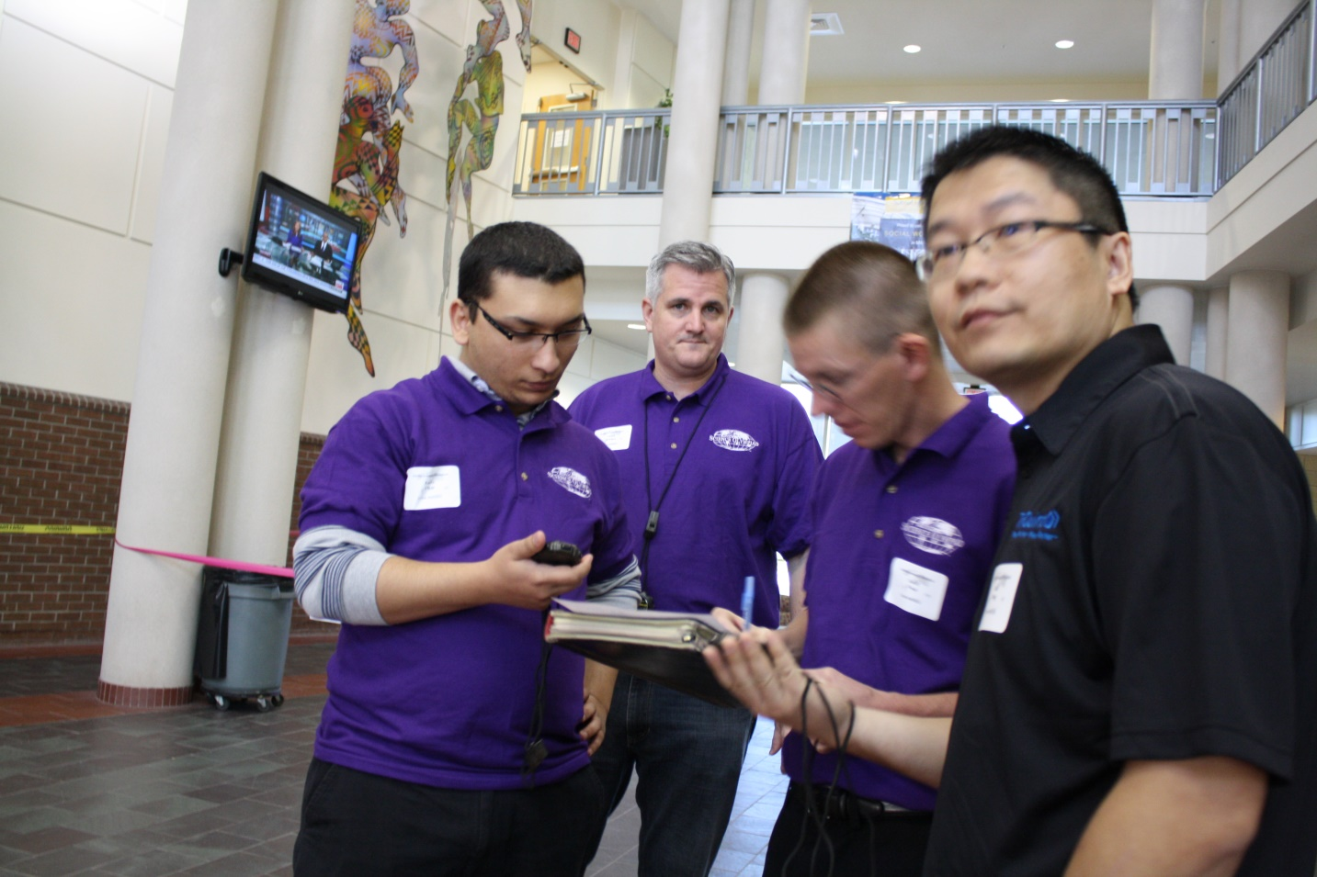
Event Supervisor Procedures

Slide 22
Team Numbers
Students must have these before they compete.
Make sure they have a wristband and check to be sure the team number is on it.
Make sure they are in the correct hour.
You also have them on the scoring summary sheet.
Students MUST sign in as they enter the room or location.
Event Supervision

Slide 23
Event Templates
To help with Scoring, make sure your test and lab sheets have a format like this one:

Slide 24
Event Start Time
Use Internet/Cell Phone Time
Let teams in even if they are late, but don’t give them extra time at the end.
It is not a benefit if they are late.
If they come in and disturb, then they can be disqualified.
Event Supervision

Slide 25
Schedule
Event Impound? Teams Allowed Times
Event Supervision

Slide 26
Event Instructions
Make sure before any student leaves your room that all materials have been returned, you have accounted for all handouts and that all supplies are clean.
To help with cleanup at end of day, please gather supplies to one place in the room.
Bring back garbage bags
Event Supervision

Slide 27
Disqualifications
If a student is outright disrespectful, they can be disqualified. In addition, multiple problems or outright cheating can result in the disqualification of the entire team.
Notify Tournament Director if there is a problem that could lead to this.
Event Supervision

Slide 28
Disqualifications
If a student is disqualified, note the reason on the Scoring Sheet and student work.
There is a difference between legitimate mistakes and blatant disregard for the rules. Make a judgment about a which category the students may fall into when assigning points.
Event Supervision

Slide 29
Disqualifications
DQ’s for scoring purposes are not:
When students attempted but didn’t follow the rules.
Built something incorrectly.
Didn’t have safety equipment.
Anything other than behavior related.
Event Supervision

Slide 30
Mistakes
You are the event supervisor, so you are empowered to make decisions.
However, if you make a mistake interpreting the rules, and catch it AFTER the first school competes, continue the mistake throughout the day.
Event Supervision

Slide 31
Arbitration
If a student has a problem with a ruling, they are instructed to pick up an Arbitration Form. These are at the help desk.
ONLY STUDENTS CAN FILE
Event Supervision

Slide 32
Arbitration
They are NOT to engage you in a prolonged debate.
The Arbitration Team will make the FINAL ruling.
Event Supervision

Slide 33
Parents and Teachers
Parents and teachers can WATCH the outside events, but they are not allowed in the door-closed rooms during events.
They must remain a distance from the events, as you so choose. But, they are not to help the students, and they are not to engage in a debate about problems.
Event Supervision

Slide 34
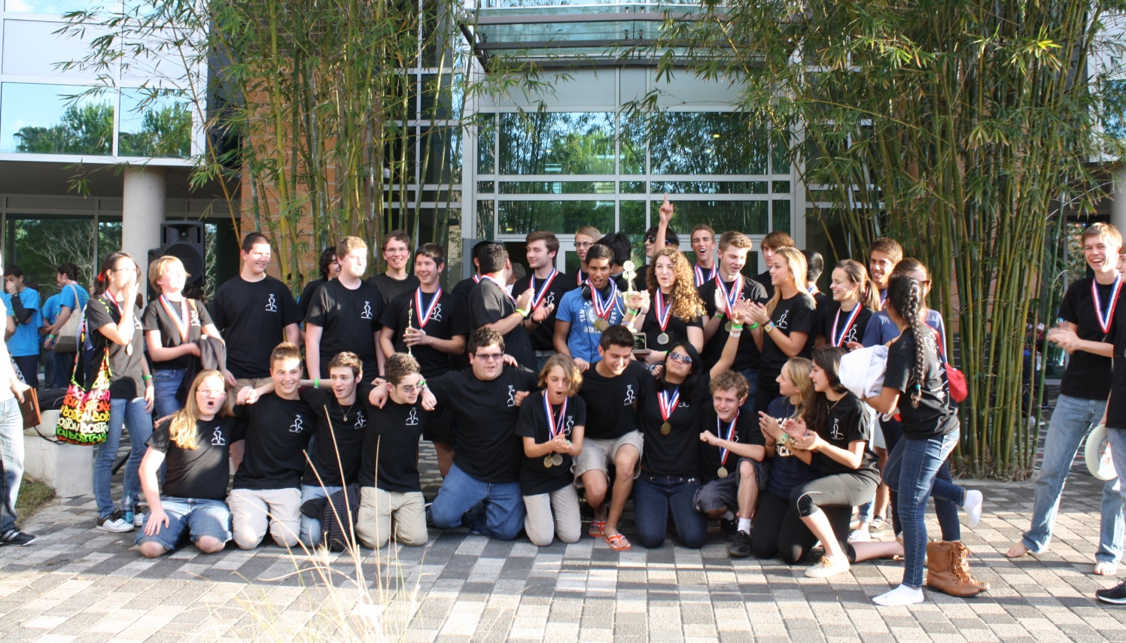
Scoring

Slide 35
Scoring
NEW SCORING PROCEDURE!
Team Ranking Points (TRP) will be assigned a range of points from 1-17
All ties must be broken for ranking points 1-16. (Except last place and beyond.)
Beyond a ranking point of 18, no ties need to be broken.
All raw scores must be determined.
Scoring

Slide 36
Scoring
Teams that rank in places 1-17 will receive 1-17 pts
Teams that rank in places 18-35 will receive 17 pts
Teams that compete but can’t be scored (rare case) receive a P and last place of those teams that show up
Teams that are No Show NS receive n+1 points or 18 pts
Teams that are disqualified (DQ) for unsportsmanlike conduct receive n+2 points (or more) or 19 points.
Lowest combined score of all the events will determine the winner of middle and high school.
Scoring

Slide 37
Scoring Example
35 Teams
n = 17
1st place = 1 TRP
2nd place = 2 TRP
18th place to 37nd place = 17 TRP
P = Variable, but most likely 17 points
NS = 18
DQ = 19+++
Ties allowed with ranking points of 17-19
Break ties with team ranking points 1-16
Scoring

Slide 38
Scoring Sheet
Fill out this sheet at the end of the event. Rank the schools from 1st to 17th Place. All ties must be broken with ranking points of 1-16. Write in rank!
Scoring

Slide 39
Excel Scoring Sheet
File is at eso.floridascienceolympiad.org , The Competition, Training.

Slide 40
Event Raw Score Spreadsheets
The event based excel spreadsheets are different from the master scoring spreadsheet. Raw scores are determined here, but need to be recorded in the master spreadsheet.

Slide 41
Scoring Sheet
Turn in the scoring summary sheet with ALL of the student work (labs, tests, scoring sheets) to the Scoring Room in the following order:
Fill out Scoring Checklist
Place student work in RANK order, 1st Place on Top
Print out Scoring Summary Sheet in CROL 102
Be ready to READ ALOUD the student work with Team No., Raw Score, Rank.
Scoring

Slide 42
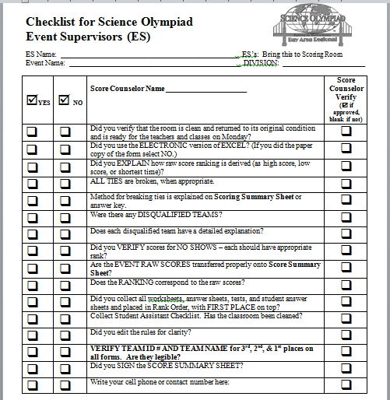
Score Counseling
To ensure that all scores have been entered correctly, scores will be verified. Make sure you fill out this form before entering score counseling

Slide 43
Scoring Summary Sheet
The scoring room is CREOL and you will be directed to a computer lab.
Please leave your cell number or stay for 1 hour after event ends. Arbitrations must be cleared for your event.
Scoring

Slide 44
Lunch!
Lunch will be available at 11:30 am.
In CREOL Lobby
Event Supervision

Slide 45
When, Where, What
CREOL 102 to pick up packets.
Meeting at 8:10 a.m in CREOL 102/103
Head to the rooms to finalize the setup and figure out any last minute issues.
Impound and Construction begins at 9:00 am
Event setup will be from 7:00 to 10:00 am
Events start at 10:00 am
Have a great day!
Event Supervision

Slide 46
For More Information:
eso.floridascienceolympiad.org
Twitter: @scienceolympiad
Email
mike@floridascienceolympiad.org
Contact

